Slide 1
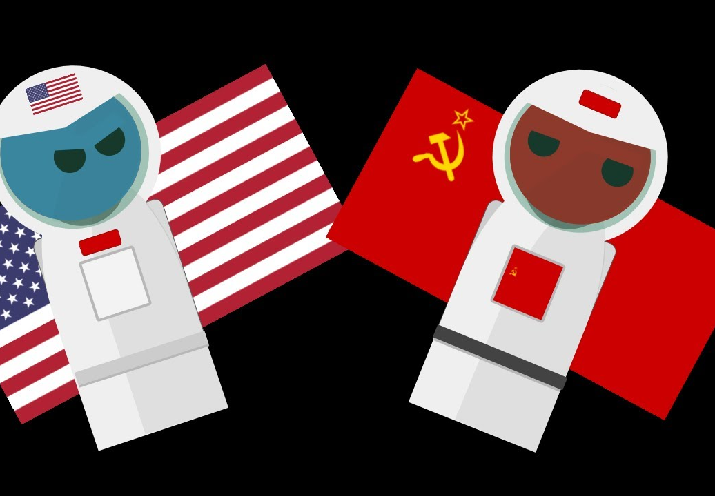
The Space Race
By ben allen

Slide 2
The space race was a competition between the us and the ussr to complete specific spaceflight goals.
THEY GOT THEIR KNOWLEDGE FROM MAKING BALLISTIC MISSLES.

Slide 3
The ussr put the first satellite ( Sputnik 1 ) Into space on october 4, 1957.

Slide 4
The first animal in space was a dog named laika in sputnik 2 by the ussr on november 3, 1957.

Slide 5
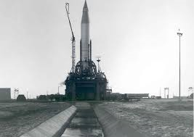
ON DECEMBER 18, 1958, THE US SENT THE FIRST COMMUNICATION SATELLITE INTO SPACE.
THE LUNA 1, SENT BY THE USSR,WAS THE FIRST OBJECT ON THE MOON.

Slide 6
ON APRIL 12, 1961, THE USSR PUT YURI GAGARIN INTO SPACE.
HE WAS THE FIRST HUMAN WHO WENT INTO SPACE.

Slide 7
The us's apollo 11 brought the first humans onto the moon on july 20, 1969, making the us the winners of the space race. The apollo 11 crew: neil armstrong, buzz aldrin, and last but certainly not least, michael collins.

Slide 8
Thank You!
By ben allen

