Slide 1
P. K. Subban
Defenseman for the New Jersey Devils

Slide 2
P. K. Subban & family
P. K. was born in Toronto, Ontario on May 13, 1980.
His real name is Pernell Karl Sylvester Subban.
P. K.’s parents are Karl and Maria and he has two brothers and two sisters.

Slide 3
P. K. subban
P. K. also has a fianc$é$ named Lindsey Vonn.
Lindsey Vonn is a alpine ski racer where she is “one of only two female skiers with three consecutive titles in 2008, 2009, and 2010.”
When their engagement happened, it was Lindsey who proposed to P. K.

Slide 4
p. K. subban
Before the NHL:
From 2005 – 2009, P. K. played with the Bellville Bulls in the OHL. He was the captain of that team and he had 190 points in those four seasons.
From 2009 – 2010, P. K. played with the Hamilton Bulldogs in the AHL and also some with the Montreal Canadiens. He had 53 points with the Bulldogs.

Slide 5
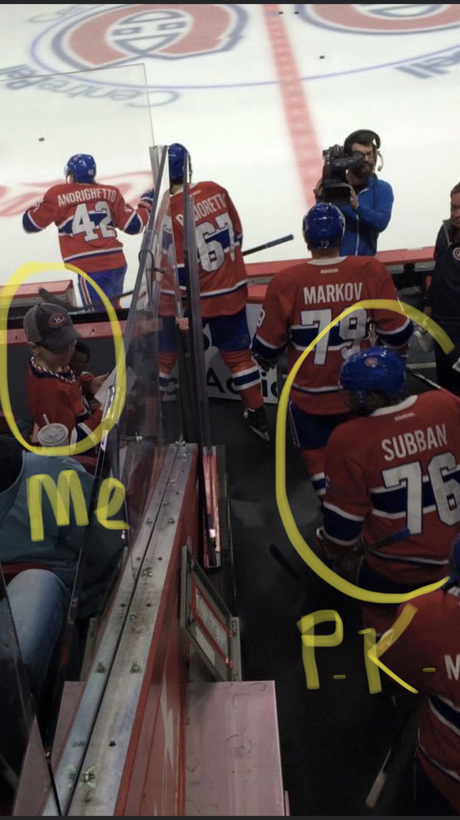
P. K. Subban
P. K. Subban played with the Montreal Canadiens from 2009 to 2016. I got to see him play twice in Montreal; once with my parents and sister and then with my Dad and grandfather.
When P. K. played for the Canadiens, he played for 9 seasons and had 278 points.
He was drafted in 2007 in the second round and was 43rd overall.

Slide 6
P. K. subban
After leaving Montreal, P. K. was traded to the Nashville Predators.
He played with Nashville from 2016 – 2019.
He had 130 points while playing with the Predators.

Slide 7
P. K. subban
After leaving Nashville, P. K. was traded to the New Jersey Devils, where he is currently playing.
Before the NHL shut down because of COVID 19, P. K. had 18 points.

Slide 8
P. k. subban
When P. K. is off the ice, he is doing a lot of charity work with the Montreal Children’s Hospital.
He donated 10 million dollars to help sick kids and when he can, he visits them in the hospital. “The $10 million from the hockey player's foundation, to be paid out over seven years, will be used in part for a fund called P.K.'s Helping Hands, which will help families struggling financially with a child's illness.”
The hospital named their atrium after P. K.

Slide 9
p. K. subban
P. K. continues to rise on and off the ice. In my opinion, he is the best offensive defenseman in the league.
In the playoffs for Montreal, he had 38 points.
In the playoffs for Nashville, he had 24 points.

