Slide 1
Le son des lettres

Slide 2
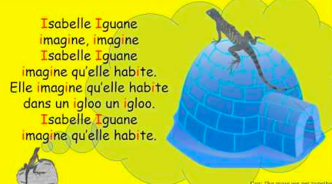
Isabelle l’igane
https://www.youtube.com/watch?v=b_f0mSa-MSI

Slide 3
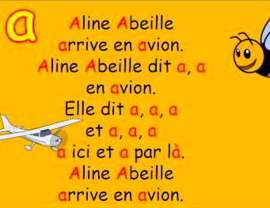
Aline l’abeille
https://www.youtube.com/watch?v=REvJkeSD83w

Slide 4
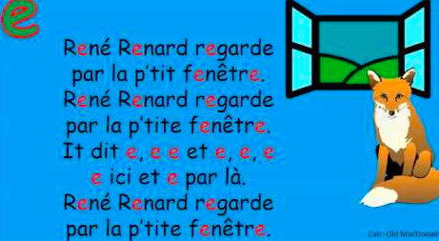
Rene renard
https://www.youtube.com/watch?v=b8ulJRo3L34

Slide 5
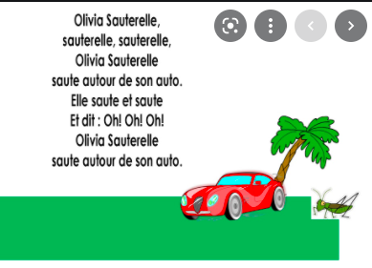
Olivia la sauterelle
https://www.youtube.com/watch?v=xVtyBiyUaNg

Slide 6
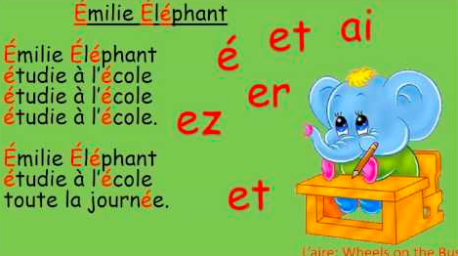
Emilie l’elephant
https://www.youtube.com/watch?v=r1oC1vjQSj8

Slide 7
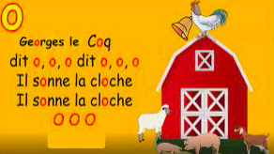
Georges le coq
https://www.youtube.com/watch?v=M4PW72Df9Oc

Slide 8
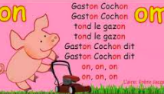
Gaston cochon
https://www.youtube.com/watch?v=bRT17t_RTLo

Slide 9
Louis l’ours
https://www.youtube.com/watch?v=xsdtnPzanoA

